Slide 1

E-Xtend
Sahiti Sri Upputuri

Slide 2
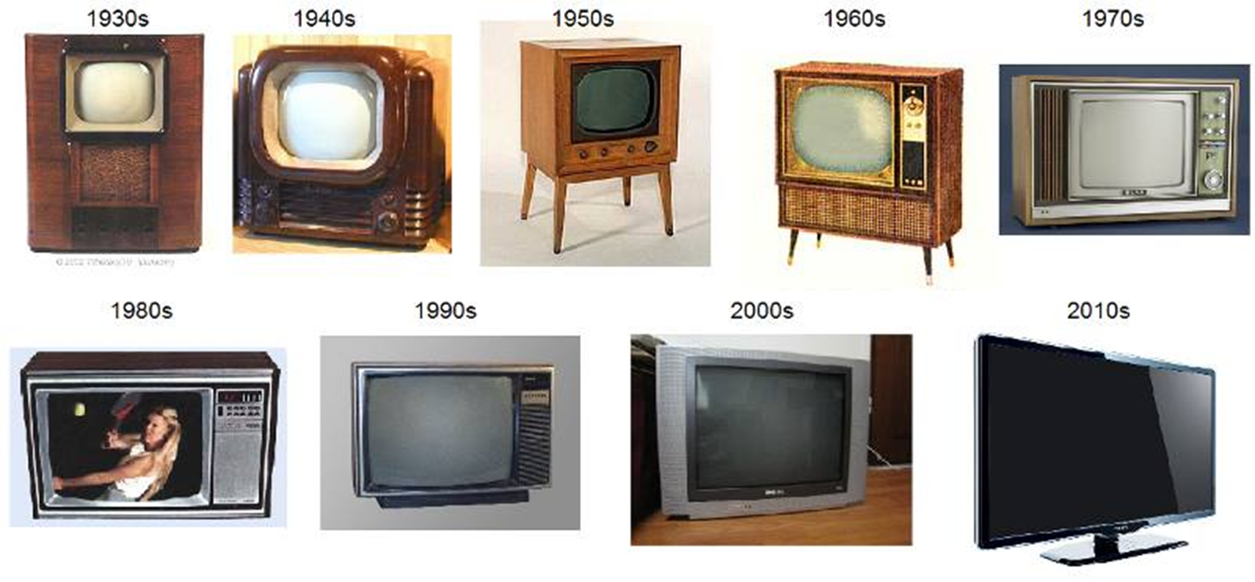

Slide 3
Problem
1. Technology Development
•300 million computers and 1 billion cellphones go into production (expected 8% growth rate per year)
•These include devices with usable screens
•LCD Desktop Monitors
•LCD Televisions Phones
•Plasma Televisions
•TVs
2. Electronic Waste
•40 million electronic waste per year
3. Harmful Toxins
•85% of our E-Waste are sent to landfills to be burned thus leading to harmful toxins

Slide 4
What Can We Do to Lessen the Amount of Harmful Toxins?

Slide 5

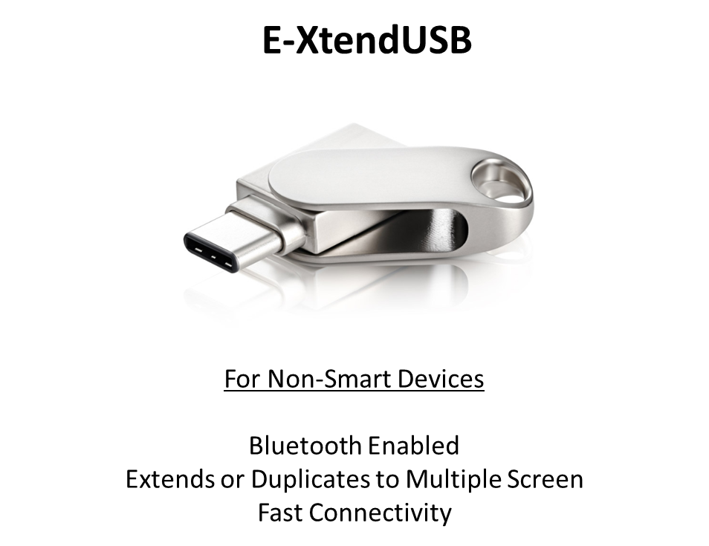
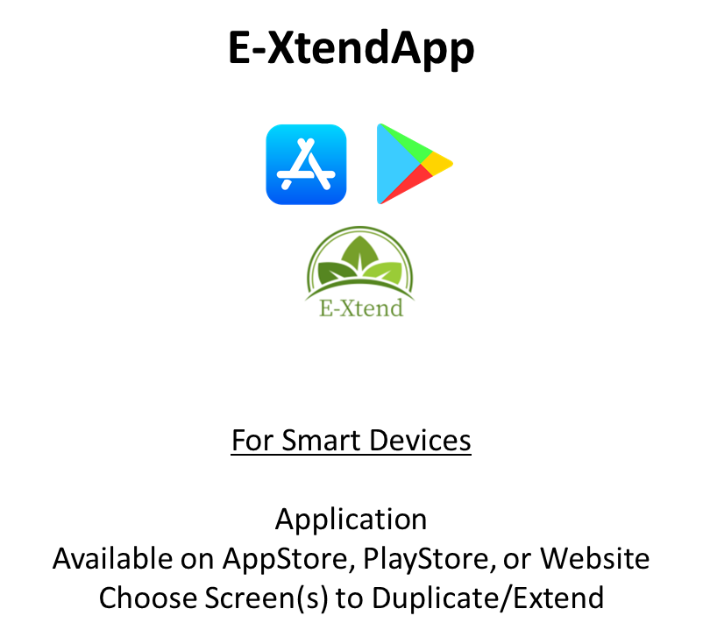
Solution

Slide 6
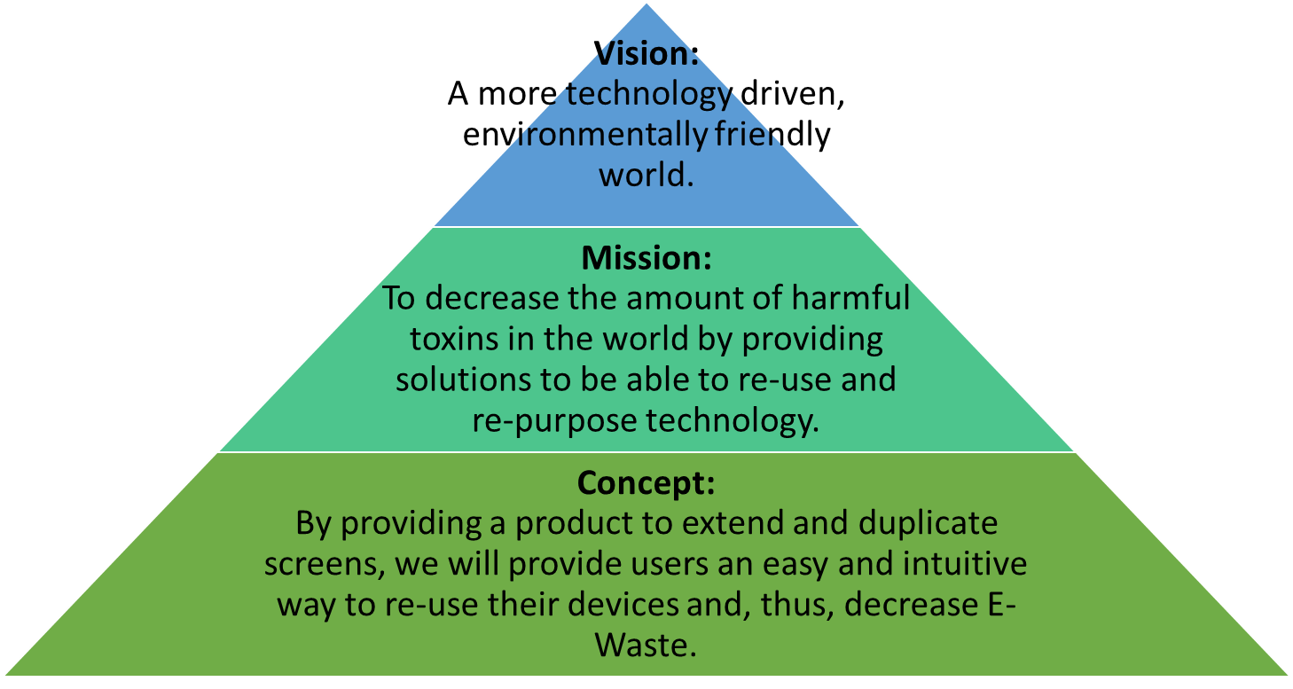
Who We Are We?

Slide 7
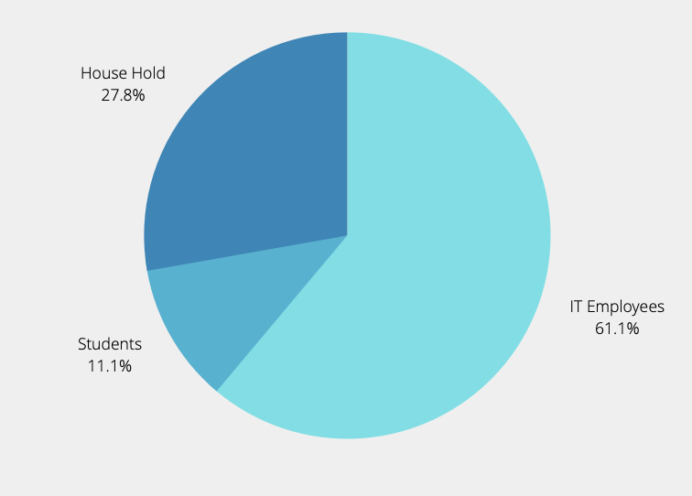
Market
Key Segments – Product, End User/Applications, Technology, and Region
E-Xtend USB
E-Xtend App
What is Target Market?
From all population, 60% are working.
Out of the 60% working, 78% are IT users.
Initial Launch Target Market (Austin): 1,074,202
Workstation Monitor | TV
Smart TV/Monitors | Workstation Monitor | Mobile

Slide 8

Competition Analysis
Features
5K Quality Streaming
Multi-Screen
IOS / Android Cross Platform
Security
HDMI Extender
Pricing
E-Xtend | Mira Screen | EZ Cast Pro
$50 | $45 | $137

Slide 9

Marketing Strategy

Slide 10
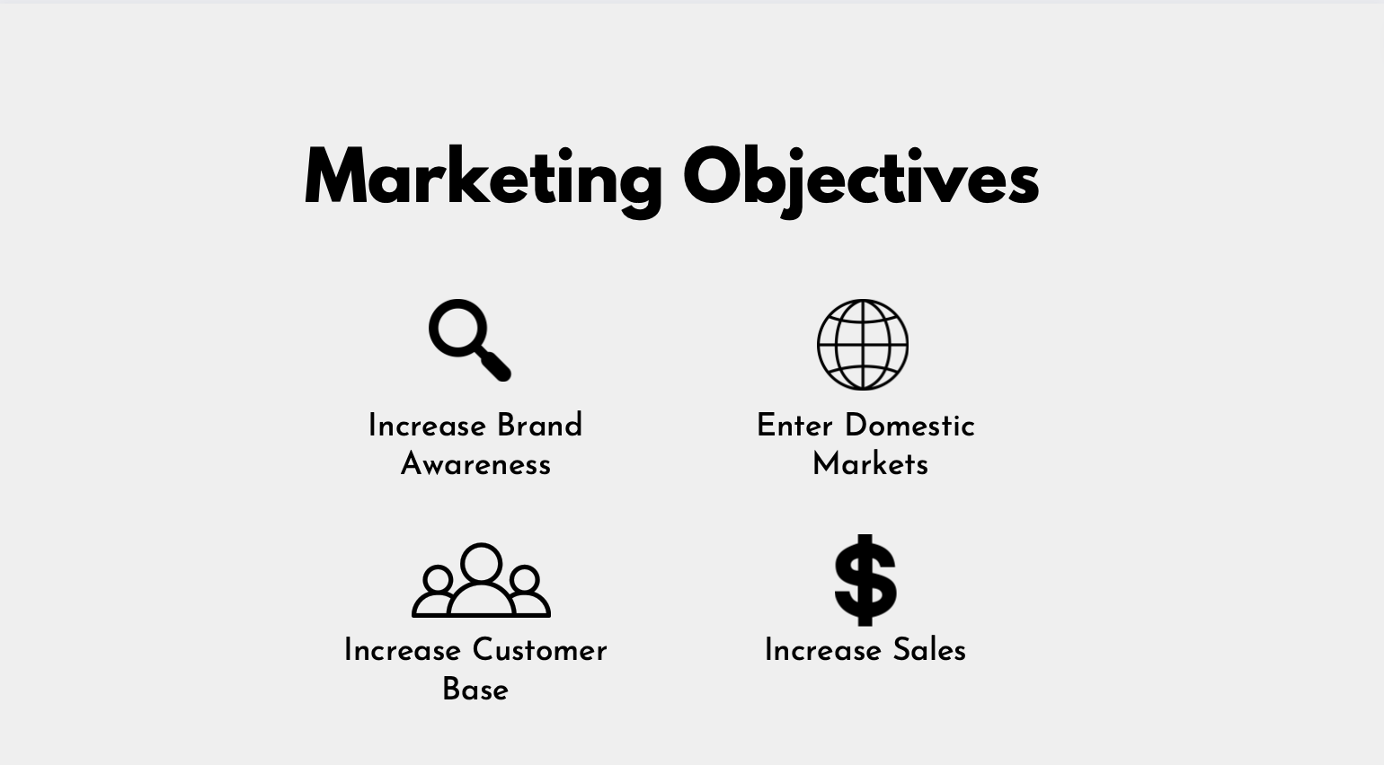

Slide 11

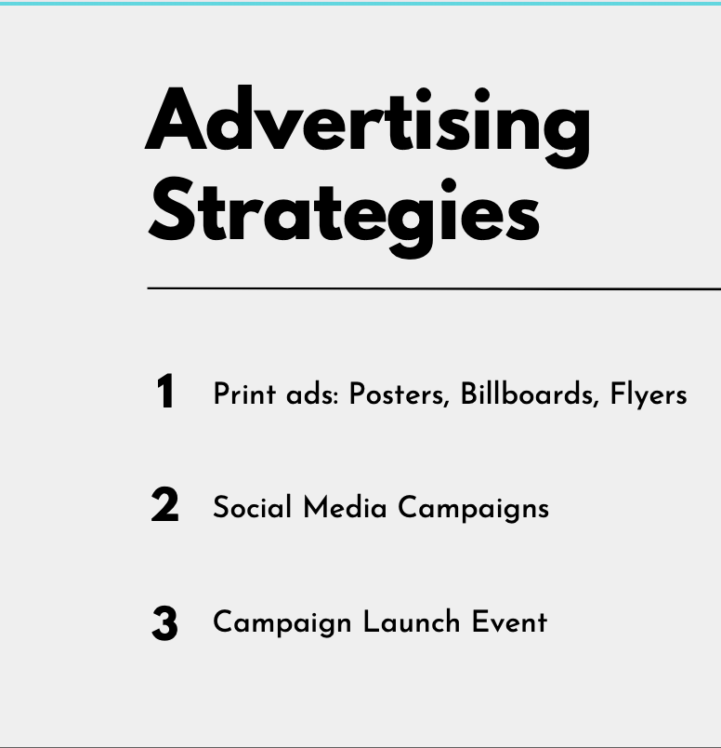

Slide 12
SWOT Analysis
Strengths Cross platform Non-profit collaboration | Weaknesses Expensive (hardware and software)
Opportunities Easily scalable (especially with application) Increasing technology speed | Threats Company lock-out Substitutes (e.g. Chromecast or Teams)

Slide 13
Business Model and Pricing
2 Revenue Channels
Hardware Sold via Amazon and Website $45.00 per piece, Lifetime Access
Software Sold via Website and 3rd Party platforms like PlayStore and AppStore $10.00 fee for 1 year access, available on unlimited devices
Key Business Angle-
$3 Donated towards e-waste management every time a hardware is sold.

Slide 14
Resources and Operations
Developers
1 CTO plus 2 Developers to start out, Adding a 4th member to the team in Year 1, 5th and 6th in Year 2 and 7th and 8th in year 3
Servers
Web Sever hosted on a platform like AWS- 2 to start out, 2 more in year 2 and 4 more year 3
Manufacturing
Outsource manufacturing to a country like China where product can be made for cheap
Website
One Website for downloading software, purchasing hardware and for other brand related activities
Office plus Warehouse
An office space to serve as working area along with a warehouse where the hardware is store and managed.

Slide 15
Timeline
30 Days: Incorporation and Set up
6 Months: Build the software, Website and supporting infrastructure
15 Days: Hire Software Developers (Simultaneously as incorporation)
3 Months (After 2 months of Software Development)
5 Months: Set up Manufacturing – Beta Testing in Austin Market and Refinement
12 Months: Launch in Dallas Market
2 Months: Launch in Rest of Texas
End of Year 1: Rollout in Louisiana, Oklahoma, and New Mexico
End of Year 2: Rollout in East Cost

Slide 16
Funding and Offerings
Screen Extender Requires $2,454,648
Bank: $1,023,509
Founders: $500,000
Outside Investors: $93,1139
Potential ROI for Investors
36.3% over 3 Years

Slide 17
Financials
Startup Budget
First Year Sales Forecast

Slide 18
Financials
Statement of Cash Flows
Balance Sheet
Income Statement

